Slide 1
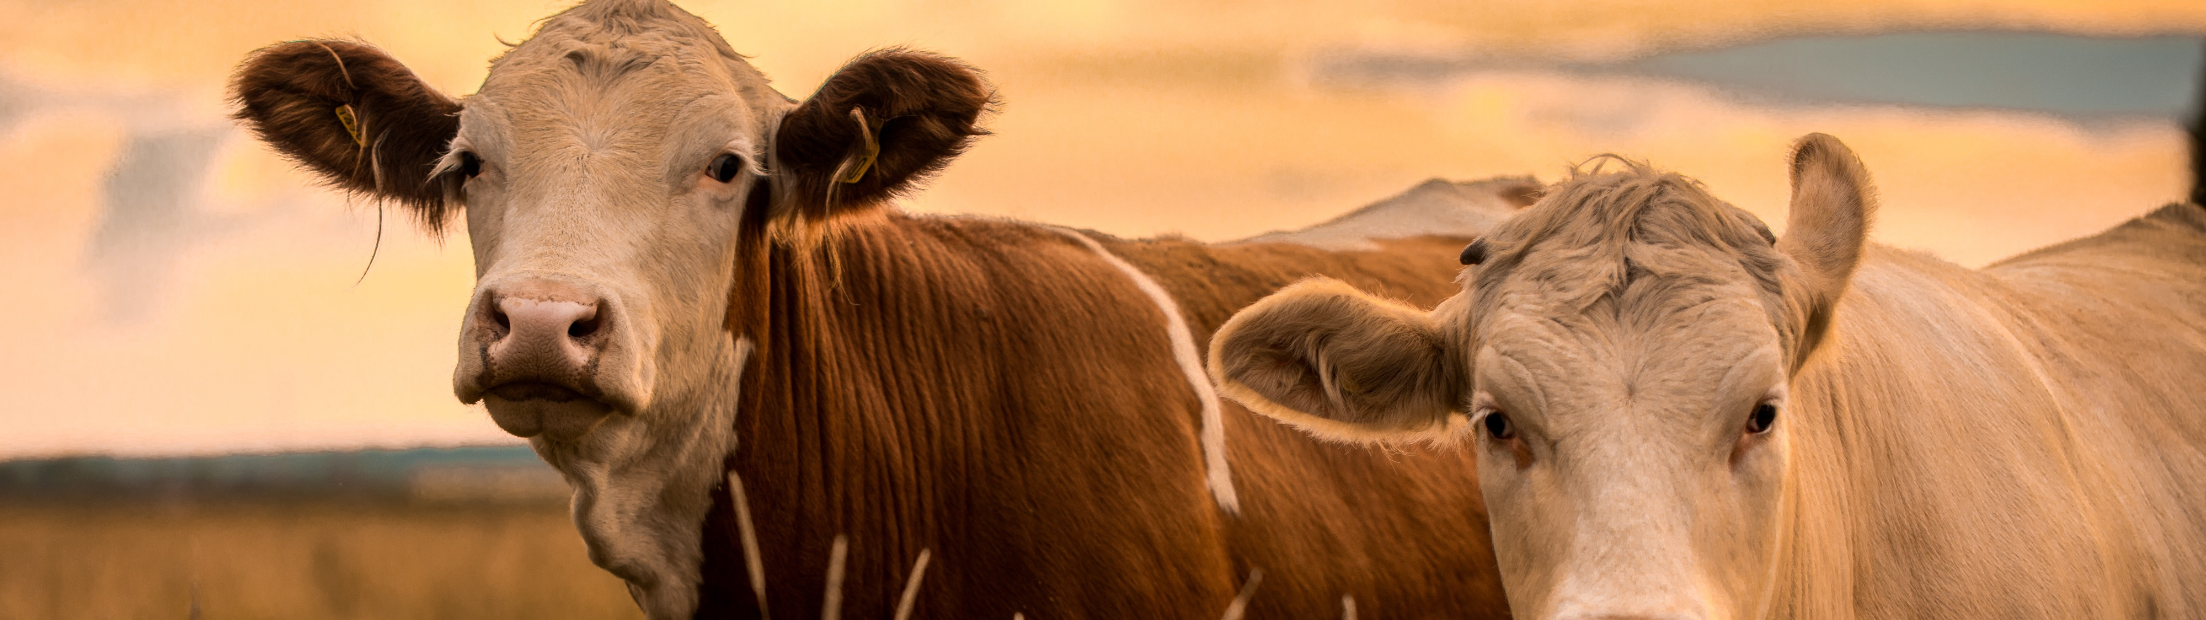

Trade-offs Between Individual Gains and Herd Gains with Increased Stock Density
John Ritten

Slide 2
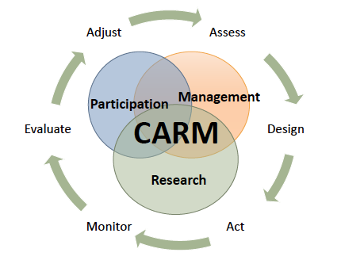
Collaborate Adaptive Rangeland Management
Stakeholder Driven Research
Adaptive Grazing at a Ranch Level
Managing for Numerous Objectives

Slide 3






Introduction- CARM
Initiated in 2012, data collection began in 2014
Long term (10 year) comparative study between a continuously grazed system and an adaptively managed rotational grazing system
The goal: To manage land in
order to pass it on to
future generations
Wildlife
Vegetation
Profitable Ranching

Slide 4
Introduction- CARM
11 stakeholders from multiple disciplines became the decision-makers for the project
The Nature Conservancy,
Colorado State Extension,
US Forest Service,
Colorado State Land Board,
Crow Valley Livestock (4 ranchers),
Bird Conservancy of the Rockies,
NRCS,
& Environmental Defense Fund
Wildlife
Vegetation
Profitable Ranching

Slide 5




Goal: Manage the land in order to pass it on to future generations
-Economically
-Ecologically
Vegetation
Profitable ranching operations
Wildlife
Collaborative
Learning
A) Attain and/or maintain abundances of cool-season perennial graminoids within 30% of targets for each plot. *
B) Maintain or increase plant compositional diversity both within and across pastures.*
C) Increase variation in vegetation structure, composition, and density within and among pastures **
D) In pastures that had stands of fourwing saltbush at the start of experiment, increase or maintain cover relative to baseline.*
Maintain or increase livestock weight gain †
Reduce economic impact of drought †
Maintain or reduce operating costs †
Increase populations of mountain plover. **
Maintain populations of McCown’s longspur, Western meadowlark, and horned lark **
Increase populations of grasshopper sparrow, Cassin’s sparrow, Brewers sparrow, and lark bunting **
Maintain control of prairie dog populations (No prairie dogs.) **
Apply new knowledge and CARM in new areas
Respect, understanding and trust increases among stakeholders and researchers
Stakeholders and researchers co-produce new knowledge

Slide 6
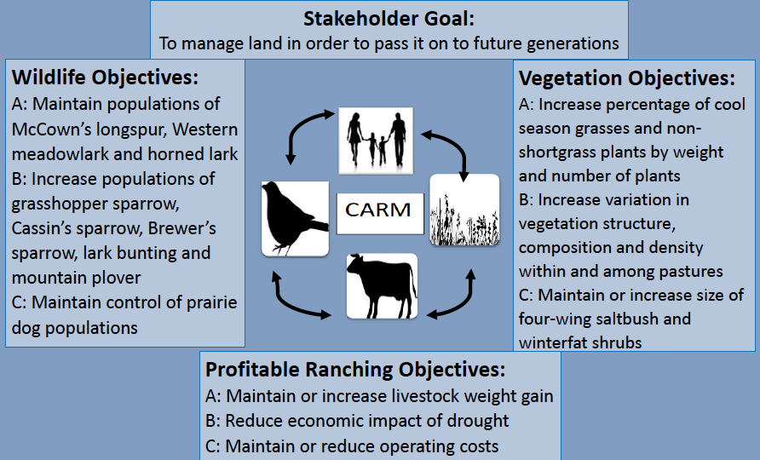

Slide 7
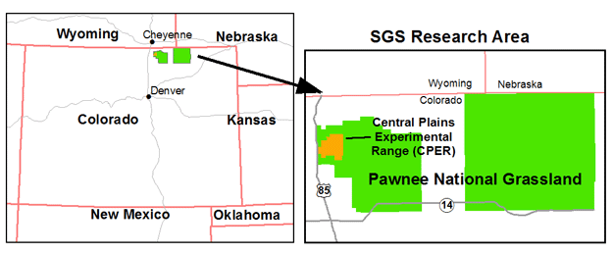
Study area

Slide 9
Adaptive vs Continuous Grazing
Same stocking rate across systems (can change yearly)
10X stock density
To burn or not (and where)
For rotation:
  Rest pastures?
  How to rotate?

Slide 10
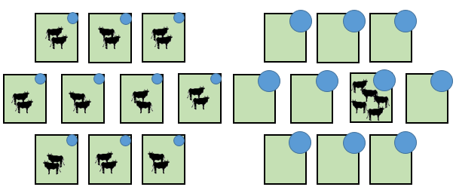
TRM CARM
Notes:
Figure 1. The five scenarios we use to model our costs are: 1) one large pasture, grazed continuously; 2) Scenario one, subdivided using permanent barbed-wire fencing, rotationally grazed; 3) Scenario one, subdivided using temporary electric fencing, rotationally grazed 4) ten non-contiguous pastures, grazed continuously, and 5) ten non-contiguous pastures, rotationally grazed.

Slide 11
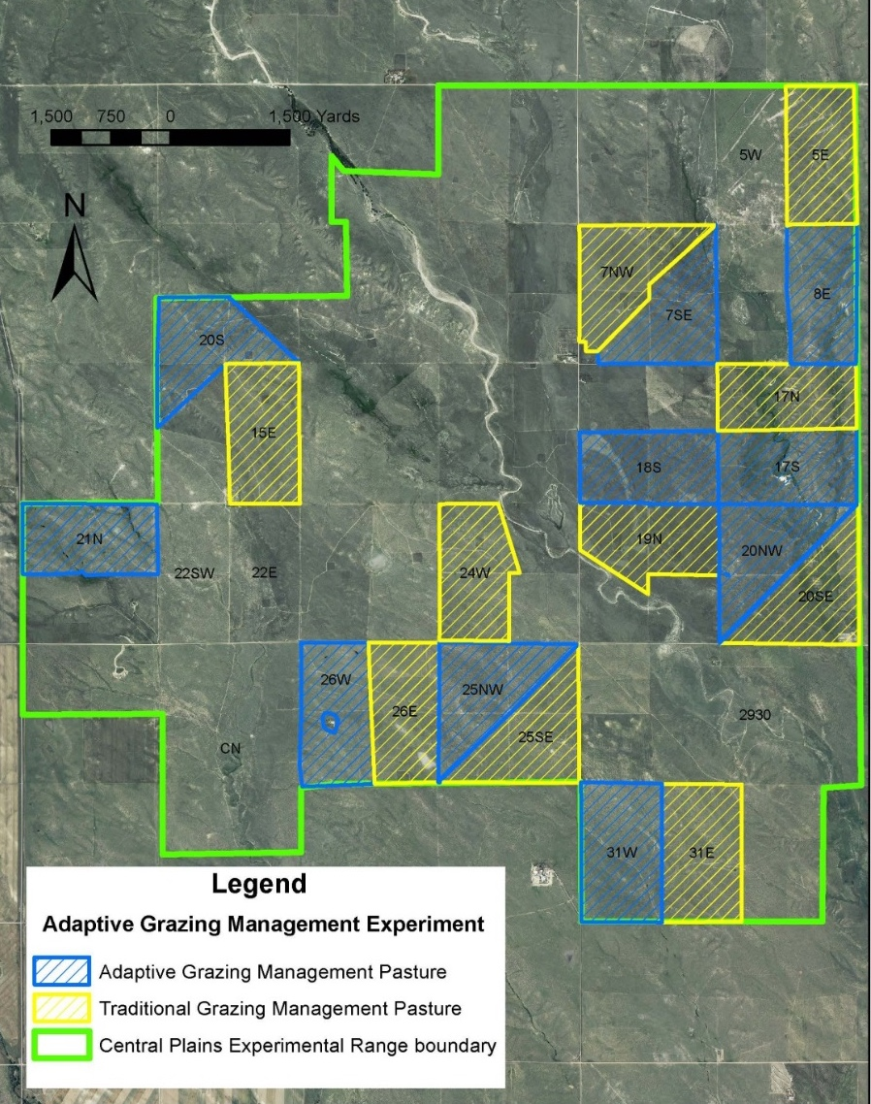
2016 Actual Grazing Sequence
May 13 – Jun 7
2 cool-season pastures grazed early (May – June)
3 warm-season pastures grazed July – early Sept
2 cool-season pastures (one with saltbush) grazed late (Sept)
3 pastures rested
rested
Sept 20 – Oct 1
Sept 6 – Sept 20
rested
Rested
Jun 7 - Jun 30
Aug 12 –
Sept 6
Jul 25 -
Aug 12
Jun 30 - Jul 25

Slide 12
Impact to forage Production?

Slide 13
Four wet/productive years
One drought
Two dry years

Slide 14
What about Animal Gains?

Slide 15
Annual Cattle Production
Only 5X density
Drought…
~16% decrease with CARM

Slide 16
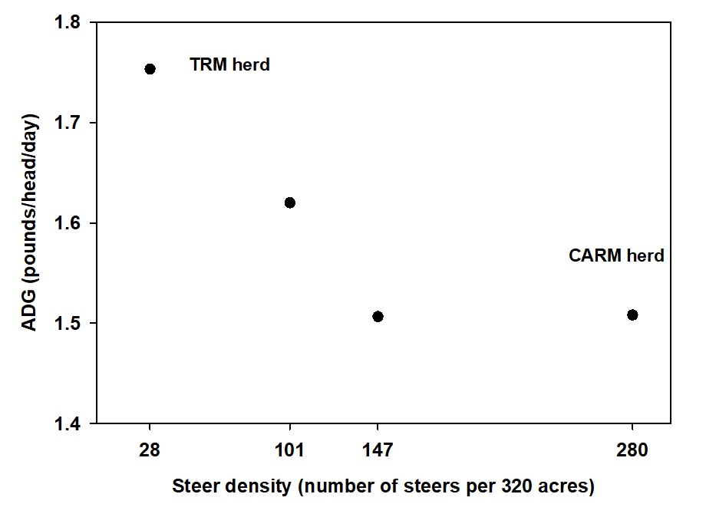
Steer Density Effects on Weight Gains 2018
Largest
herd,
rotational
and adaptive
4% increase in weight gains
(approx. 0.06 pounds/head/day) attributed to “adaptive management”
Many small
herds, no rotation
Larger herds, rotational, not adaptive

Slide 17
What if we back off density?

Slide 18
2022 Gains
-Drought/5X Density
1.721
1.737

Slide 19
2022 Gains
17N
7NW
20SE
19N
26E
24W
5E
15E
25SE
31E

Slide 20
2022 Gains
-Drought/5X Density
CARM 1 herd
on loamy pastures
CARM 2 herd
on sandy and mixed pastures
1.934
1.541

Slide 21
2022 Gains
-Drought/5X Density
Benefits of CARM here
(and with patch burn too)
1.541
1.303

Slide 22
2022 Gains
-Drought/5X Density
Lacking benefits of CARM
with high stocking density
2.136
1.934

Slide 23
But, Does it Pay?
How are you marketing?
If contracting cattle, likely no price slide for lighter animals
At sale barn, lighter cattle usually get slightly higher price/cwt

Slide 25
Average Difference:
$66.86/head
Only 5X density/drought

Slide 27
Average Difference:
$25.05/head
Only 5X density

Slide 28
Comparison for Years with 10X stock density
*Added value BEYOND purchase cost
Notes:
Still 12-16% decrease in gains, but only 10% decrease in returns – price slide is important – marketing skills are important.

Slide 29
What about costs?
Operationally dependent…
Need to include:
Infrastructure
  Fence (type and amount)
  Water
Labor

Slide 32
Annual Cost of Labor

Slide 33
Total Annual Grazing System Costs

Slide 34
Can it pay?
Overall profitability was ~5-25% lower with rotational grazing
BUT, cost-share might cover the difference
Operationally dependent
  More likely with dispersed
Need to account for lower weights when contracting/marketing

Slide 35
Lessons learned from monitoring diet quality
Cattle Production: CARM < TRM
Forage Production: CARM = TRM
Diet Quality: CARM < TRM
Diet quality is key driver of weight gains in non-drought years

Slide 36
More lessons learned…
Contract for a lighter weight when implementing increased stock density
Rotation allows for drought adaptation, regardless of price slide
  But, only due to the less severe negative impact
Decreased Density increases both Revenues and Costs
Target increased density to certain pastures
Marketing earlier can be advantageous

Slide 37
Interaction between Stocking Rate and Marketing Date

Slide 38
Average of net return per hectare
 | Light |  |  | Mod |  |  | Heavy
 | Aug | Sep | Oct | Aug | Sep | Oct | Aug | Sep | Oct
Average | $16.51 | $14.01 | $12.03 | $18.01 | $18.98 | $15.57 | $24.59 | $25.67 | $19.35
Rank | 6 | 8 | 9 | 5 | 4 | 7 | 2 | 1 | 3
% > $0.00 | 86.9% | 82.2% | 74.1% | 83.0% | 82.8% | 73.7% | 81.0% | 80.7% | 70.3%
5th Percentile | ($9.91) | ($13.37) | ($21.15) | ($17.12) | ($17.67) | ($28.64) | ($28.07) | ($29.23) | ($46.88)
95th Percentile | $43.74 | $41.24 | $48.88 | $51.60 | $54.96 | $60.91 | $74.48 | $79.05 | $86.39

Slide 40
Thank You!
john.ritten@colostate.edu
AgNext.colostate.edu

